Slide 1
Learn how to animate your Android App
View Android Development course details at www.edureka.co/android-development-certification-course
For Queries:
Post on Twitter @edurekaIN: #askEdureka
Post on Facebook /edurekaIN
For more details please contact us:
US : 1800 275 9730 (toll free)
INDIA : +91 88808 62004
Email Us : sales@edureka.co

Slide 2
Objectives
In this webinar, we will discuss:
Path Interpolator
Activity Transitions in Android
Sync Transition and Animation
Animating an Android Application

Slide 3

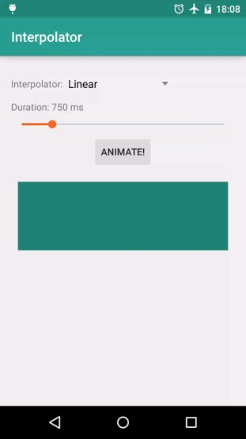
Path Interpolator
An interpolator can traverse a Path that extends from Point (0, 0) to (1, 1).
The x coordinate along the Path is the input value and the output is the y coordinate of the line at that point.
res/interpolator/linear.xml
<linearInterpolator />
29

Slide 4
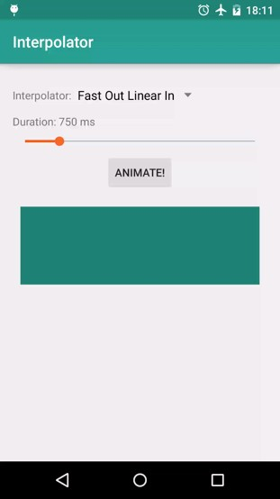
Path Interpolator
res/interpolator/fast_out_linear_in.xml
<pathInterpolator android:controlX1="0.4" android:controlY1="0" android:controlX2="1" android:controlY2="1"/>
30

Slide 5
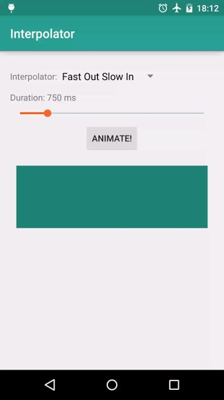
Path Interpolator
res/interpolator/fast_out_slow_in.xml
<pathInterpolator android:controlX1="0" android:controlY1="0" android:controlX2="0.2" android:controlY2="1"/>
31

Slide 6

Path Interpolator
res/interpolator/linear_out_slow_in.xml
<pathInterpolator android:controlX1="0" android:controlY1="0" android:controlX2="0.2" android:controlY2="1"/>
32

Slide 7

The Interpolator Party !!
34

Slide 8
Activity Transitions
Window Transitions animate windows
Activity transitions animate window components
Animate when launching one activity from another
Shared elements are transferred via ActivityOptions
Based on the Transitions API released with KitKat
40

Slide 9
Enable Transitions
MainActivity.java
getWindow(). requestFeature(Window.FEATURE_CONTENT_TRANSITIONS);
res/values/theme.xml
<style name="BaseAppTheme" parent="android:Theme.Material">
<!-- enable window content transitions -->
<item name="android:windowContentTransitions">true</item>
</style>

Slide 10
Activity Transition
res/values/theme.xml
<style name="BaseAppTheme" parent=“android:Theme.Material”>
<!-- specify enter and exit transitions -->
<item name=“android:windowEnterTransition">
@transition/explode</item>
<item name=“android:windowExitTransition”>
@transition/explode</item>
</style>

Slide 11
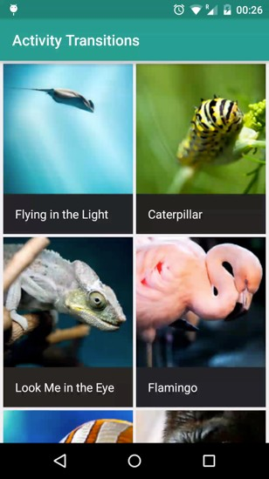
Example
43

Slide 12
Activity A
res/layout/grid_item.xml
<LinearLayout android:layout_width="match_parent" android:layout_height="wrap_content" android:orientation="vertical">
<ImageView android:id="@+id/imageview_item" android:layout_width="match_parent" android:layout_height="match_parent"/>
<TextView android:id="@+id/textview_name" android:layout_width="match_parent" android:layout_height="wrap_content"
android:background=“?android:attr/colorPrimary"/>
</LinearLayout>

Slide 13
Activity B
res/layout/detail.xml
<LinearLayout android:layout_width="match_parent" android:layout_height="wrap_content" android:orientation="vertical">
<ImageView android:id="@+id/imageview_header" android:layout_width="match_parent" android:layout_height="match_parent"/>
<TextView android:id="@+id/textview_title" android:layout_width="match_parent" android:layout_height="wrap_content"
android:theme="@android:style/Theme.Material"/>
</LinearLayout>

Slide 14
TransitionActivity.java
ActivityOptionsCompat activityOptions = ActivityOptionsCompat.makeSceneTransitionAnimation(
this,
new Pair<View, String>(view.findViewById(R.id.imageview_item),
DetailActivity.VIEW_NAME_HEADER_IMAGE), new Pair<View,
String>(view.findViewById(R.id.textview_name), DetailActivity.VIEW_NAME_HEADER_TITLE));
// Now we can start the Activity, providing the activity options as a bundle ActivityCompat.startActivity(this, intent, activityOptions.toBundle());
46

Slide 15
DetailActivity.java
@Override
protected void onCreate(Bundle savedInstanceState) { super.onCreate(savedInstanceState); setContentView(R.layout.activity_transition_details);
/**
Set the name of the view's which will be transition to, using the static values above.
This could be done in the layout XML, but exposing it via static variables allows easy
querying from other Activities
*/ ViewCompat.setTransitionName(mHeaderImageView,
VIEW_NAME_HEADER_IMAGE);
ViewCompat.setTransitionName(mHeaderTitle, VIEW_NAME_HEADER_TITLE);
}
47

Slide 16
Shared Element Transition
res/layout/fragment_sample.xml
<ImageView android:layout_width="200dp" android:layout_height="200dp" android:id="@+id/robotoView" android:layout_centerVertical="true"
android:layout_centerHorizontal="true" android:background=“@drawable/magic” android:transitionName=“@transition/my_transition”/>
res/transition/grid_detail_transition.xml
<transitionSet xmlns:android=“…”>
<changeBounds/>
<changeImageTransform/>
</transitionSet>

Slide 17
Sync Transition and Animation
DetailActivity.java
getWindow().getEnterTransition().addListener(new Transition.TransitionListener() {
@Override
public void onTransitionEnd(Transition transition) { mFab.animate()
.translationY(0)
.setInterpolator(new OvershootInterpolator(1.f))
.setStartDelay(300)
.setDuration(400)
.start();
}
});
50

Slide 18
Animate Before Transition
DetailActivity.java
@Override
public void onBackPressed() { mFab.animate()
.translationYBy(2 * 56)
.setInterpolator(new OvershootInterpolator(1.f))
.setDuration(400)
.withEndAction(new Runnable() {
@Override
public void run() { finishAfterTransition();
}
});
}

Slide 19
For Queries: Post on Twitter @edurekaIN: #askEdureka Post on Facebook /edurekaIN

